Slide 1
Environmental Impacts and Engineering Responses: Roman Ports and Salt Works
Elizabeth Kaiser
University of St. Thomas, St. Paul, Minnesota
This research was made possible in part by the Undergraduate Research Opportunities Program

Slide 2
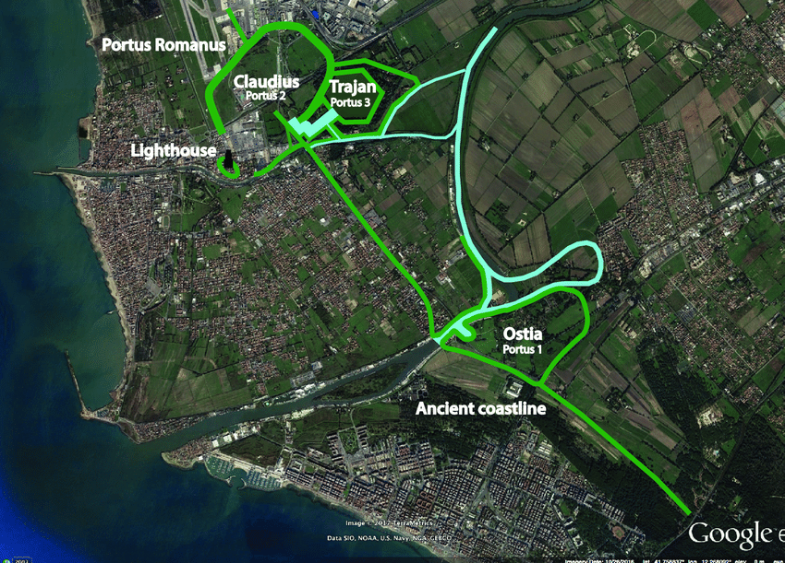
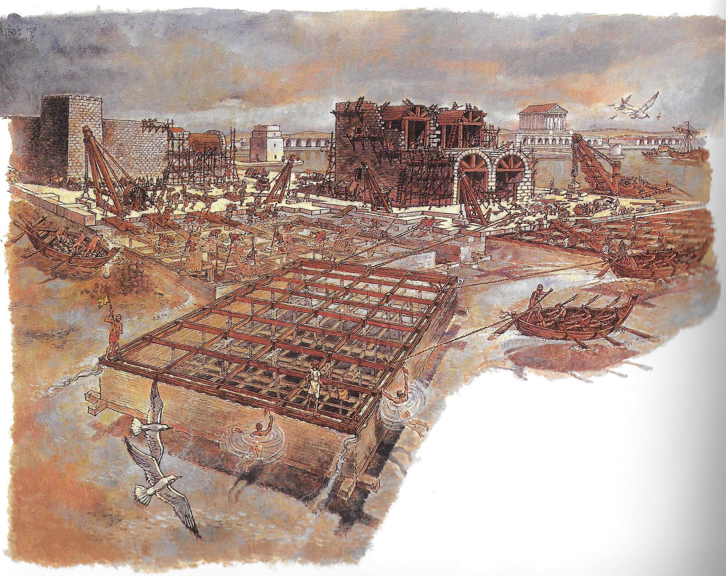
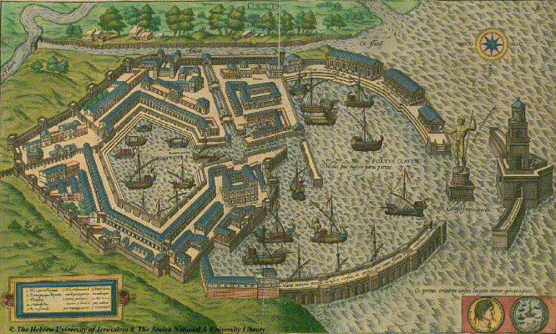
Roman Ports
Ports were important to the Roman economy and daily life. They provided food and other goods to the people of the Roman Empire. The ports were built with a technological advancement in engineering. Hydraulic concrete was used so that Romans could build almost anywhere. It allowed to build in the water, which was previously a hinderance to where a port would be located (Lancaster 2009, 5-6).
Ostia and Portus were the great ports of Rome. Portus was built once Ostia could no long keep up with shipping demands. They both were used until they could no long keep up with maintenance due to the environmental challenges that they faced .
One of those environmental challenges the ports were combating was silting, or the gathering of debris and sand in harbors. To remove silt, dredging must be done. Dredging is still used today to combat silting (“Dredging”, 2020).
Tiber River
Photo found at: https://www.researchgate.net/figure/5-Overlay-of-the-archaeological-sites-of-Ostia-and-Portus-Romanus-onto-the-present-day_fig3_333557637
Photo found at: http://www.ancientportsantiques.com/ancient-port-structures/vitruvius/
Photo found at: Marriner, N. and C. Morhange. “Geoscience of Ancient Mediterranean Harbors.” Earth-Science Reviews, vol. 80 no. 3, 2007, pp. 137-94. Web.

Slide 3
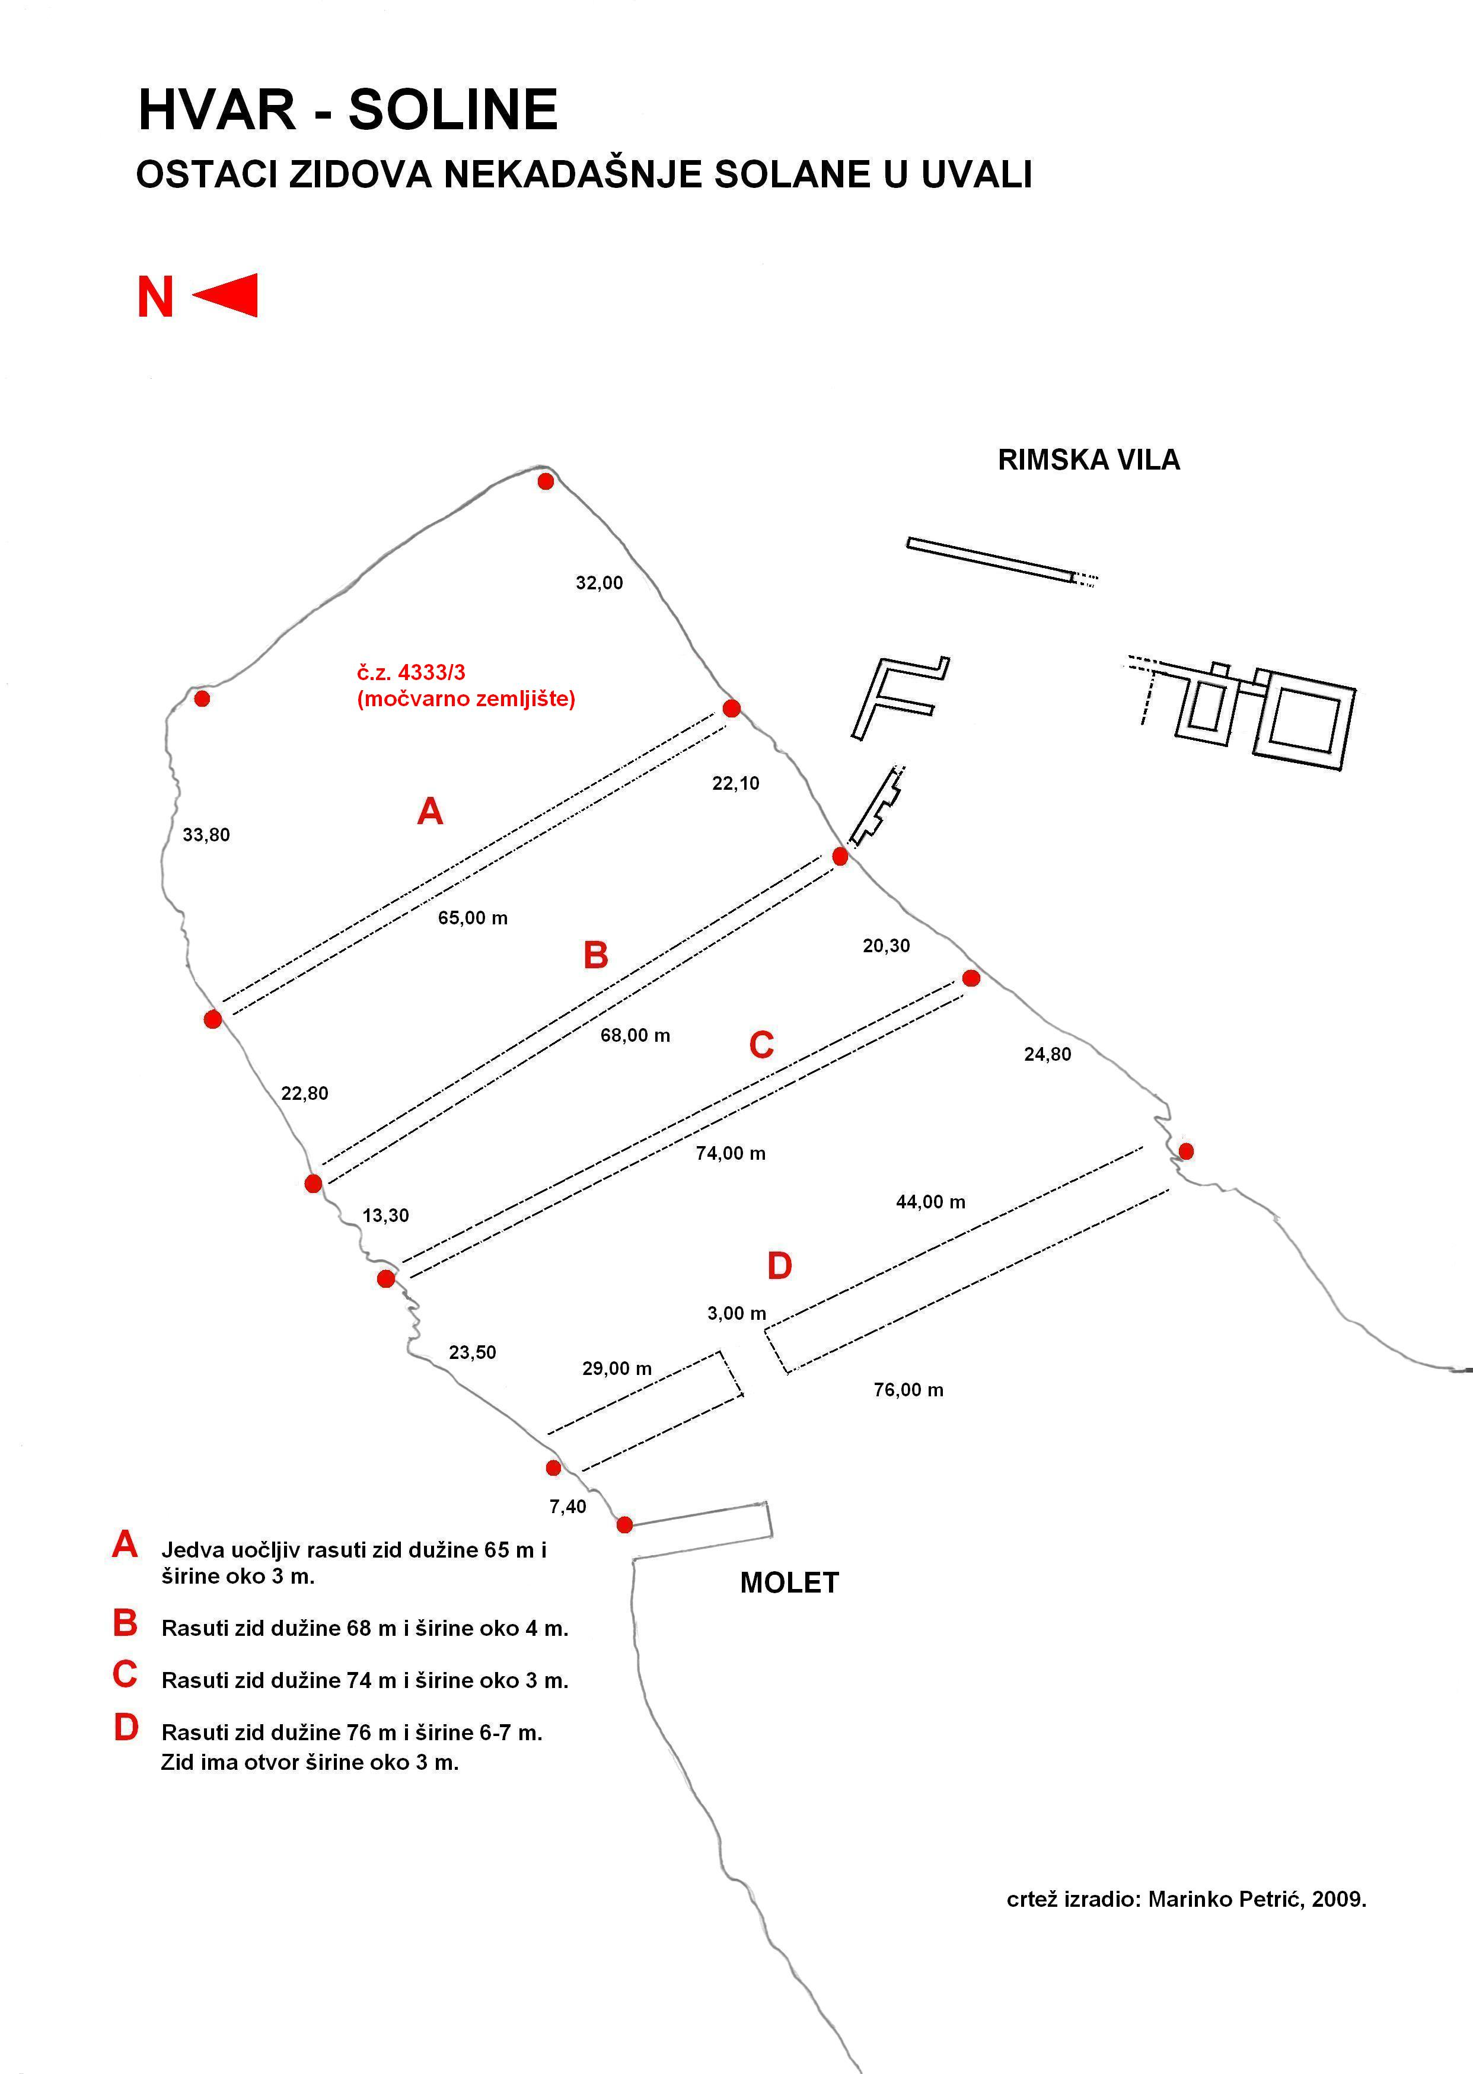
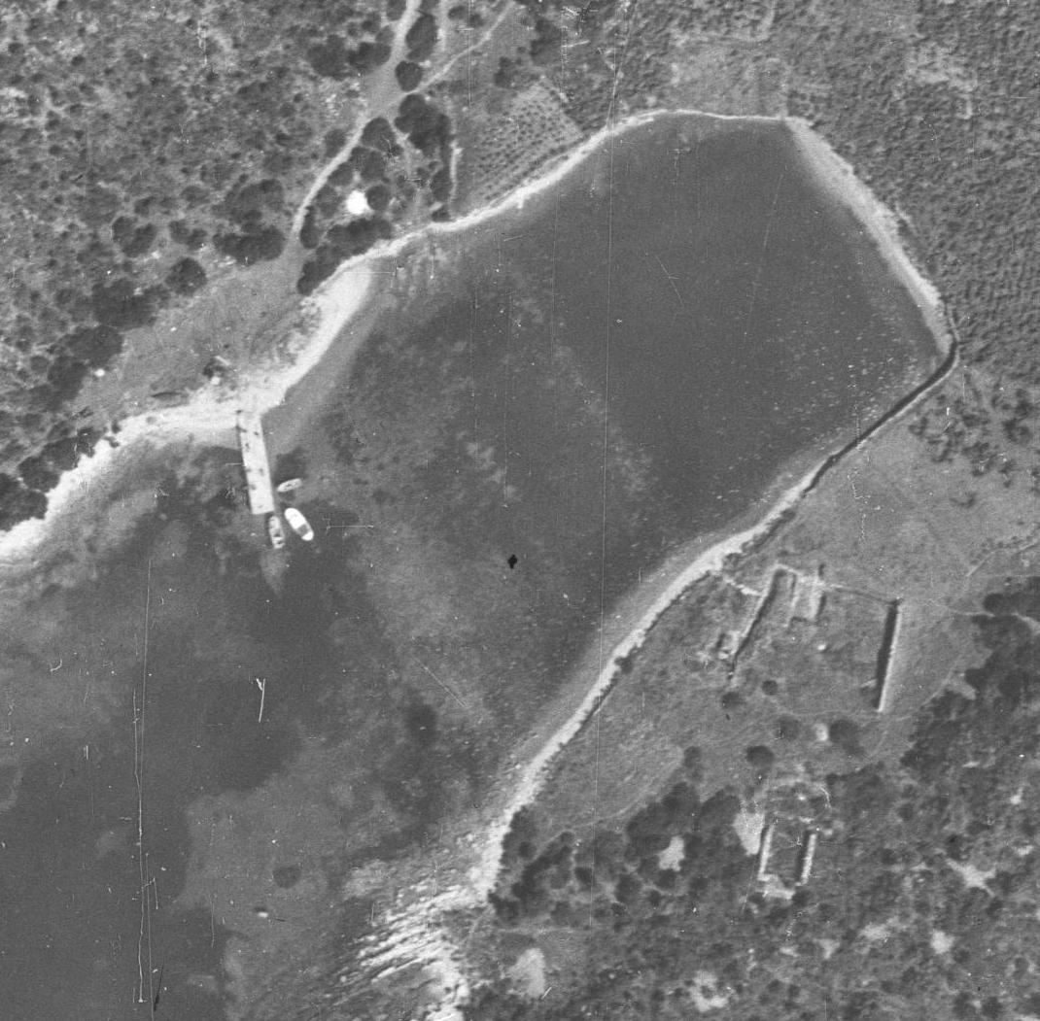
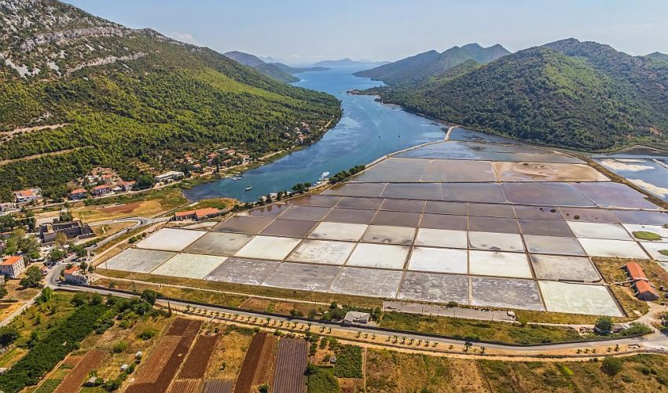
Roman Salt Works
Salt works were important to the Roman economy and lifestyle. These installations provided means to be able to preserve food, rations for soldiers and aid in medicine (Stallibrass 2008, 117-122). Studying these salt works proves to be difficult due to the rising sea levels and unkept maintenance.
The ancient salt works that were found near a Roman Villa in Soline Bay, Croatia were likely to be locally owned and therefore upkept by the owners, not the government (Begović, 2012). The salt works of Ston, Croatia, have been owned by the government since the 19th century; therefore the upkeep was the responsibility of the government. The upkeep of these installations has always been expensive and was likely one of the leading factors to abandonment of locally owned salt works (Piplović, 2003).
Being built of stone and concrete as well as being located close to sea, the installations would have had difficulty to combat the rising levels of the sea. Height could have been added to the walls that surround each pond. Compared to silting, which gathered at a faster rate, the rising sea level would have been unnoticeable from day to day (Walsh 2014, 52). Today, to combat high water levels we build a levy system (Russell, 2017). There has been evidence that this has been done in medieval and modern times (Piplović, 2003).
Photo found at: Kirigin, B., Schrunk, I., Begović, V., Petrić, M., Ugarković, M., “Istraživanje rimske vile u Solinama na otoku Sv. Klement (Pakleni otoci), Hvar,” Annales Instituti Archaeologici VI, (2010) 53-59.
Photo found at: https://guidetocroatiablog.wordpress.com/2017/03/01/town-of-ston-and-mali-ston/

Slide 4
References
Begović, V., et. al, “Roman villa in the Soline cove on the Island of St Clement near Hvar Preliminary analysis of the architecture according to geophysical investigations and sondages.” Prilozi Instituta za arheologiju u Zagrebu, Vol. 29, 2012, 143-166.
Lancaster, L., The Oxford Handbook of Engineering and Technology in the Classical World. Oxford UP, 2009. Web.
Piplović, S. “Prilog poznavanju dalmatinskih solana u XIX. stoljeću (Dalmatian Salt Works in the XIXth Century).” Radovi Zavoda povijesnih znanosti HAZU, Vol. 45, 2003, 309-326.
Russell, P. R. “Special Report: How Engineers Are Preparing for Sea Level Rise.” Engineering News-Record, 10 Aug. 2017, https://www.enr.com/articles/42487-special-report-how-engineers-are-preparing-for-sea-level-rise.
Stallibrass, S., & Thomas, R. Feeding the Roman Army: The Archaeology of Production and Supply in NW Europe. Oxbow Books, 2008.
“What is Dredging?” National Ocean Service, https://oceanservice.noaa.gov/facts/dredging.html. Accessed 21 Apr. 2020.
Acknowledgements
This research was made possible by the University of St Thomas Collaborative Grant with the mentorship of Ivančica Schrunk.

